Slide 1

SMART SENSING USING
RFID TECHNOLOGY
Project Guide:
Mrs. K. Jhansi Rani,
Assistant Professor,
Department of E.C.E.,
G.V.P.C.O.E.(A).
Name of the students:
1. N.Anil Kumar (16131A04E9)
2. P.Spoorthi(16131A04G2)
3. Md.Omar Shabbir Ali (16131A04D2)
4. P.Nagarjun (16131A04H3)

Slide 2
TABLE OF CONTENTS:
Introduction
Abstract
Types of Sensors involved
Introduction to RFID
ARDUINO MEGA
Interfacings done
4 Channel Relay module
Actuators used
Code Logic and Results
Applications
Results
References

Slide 3
Introduction:
Now-a-Days mass gathering places like shopping malls, movie theatres etc., are becoming familiar in urban or semi-urban areas. The authorities must maintain proper measure to ensure proper public safety and security of visitors.
In this project, an attempt is made to enforce a mechanism that keeps authorities to have continuous monitoring on various operational equipment like HVAC(Heating, Ventilating and Air conditioning).

Slide 4
SMART SENSING USING RFID TECHNOLOGY
Abstract:
The main concept of this project is to overcome the security issues in smart buildings an houses,
a live monitoring system should be maintained to monitor the individuals whoever enters and
exit from the building, where we should be able to calculate the time spent by an individual
person inside the building by this, If any suspicious incident is occurred inside the building, we
can be able to sort out the situation easily. The new smart sensors will be able to produce
information about their environment and share it us.
Radio-frequency identification (RFID) technology can have a significant impact in this regard. It
is a wireless data-capturing technique that utilizes RF energy for automatically extracting the
identity of remotely placed objects. Identifying smart materials with multi sensing capabilities
along with their RF characterization, as well as creating sensor designs for various applications,
opens new research horizons for chip less RFID sensing technologies.

Slide 5
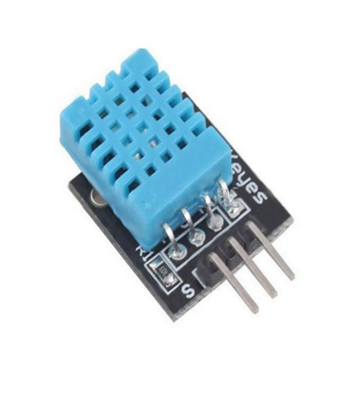
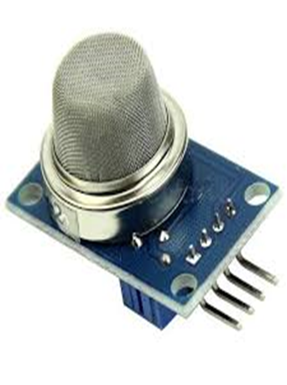
Types of sensors involved :
DHT11
Temperature and Humidity Sensor
3 Pins
MQ2 (Grove Gas Sensor)
detects LPG, Smoke, Alcohol, Propane, Hydrogen, Methane and Carbon Monoxide concentration`s anywhere from 200 to 10000ppm.

Slide 6
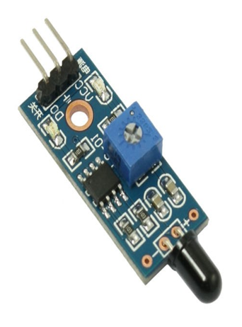
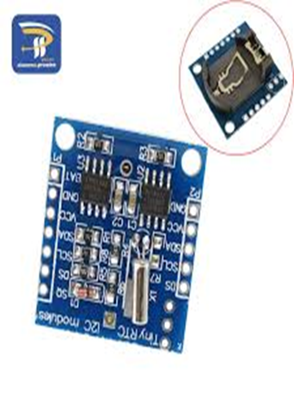
Types of sensors involved :
Flame Sensor
Used in Wavelength of 760 – 1100nm range.
4 pins
RTC (Real Time Clocks)
DS 1307
Low power clock/calendar

Slide 7
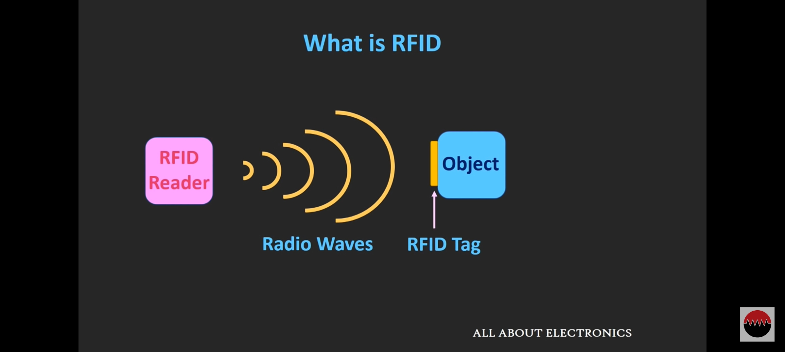
INTRODUCTION to rfid :
RFID referred to as Automatic Identification and Data Capture(AIDC).
RFID consists of three components
1.RFID Tag
2.RFID Reader
3.Antenna
RFID Tag contains an integrated circuit and an antenna, which is used to transmit data to RFID reader.
The reader then converts the radio waves to a more usable form of data.
RFID Tag is again classified into three types:
1.Active Tags, 2.Passive Tags, 3.Semi-Passive Tags.

Slide 8
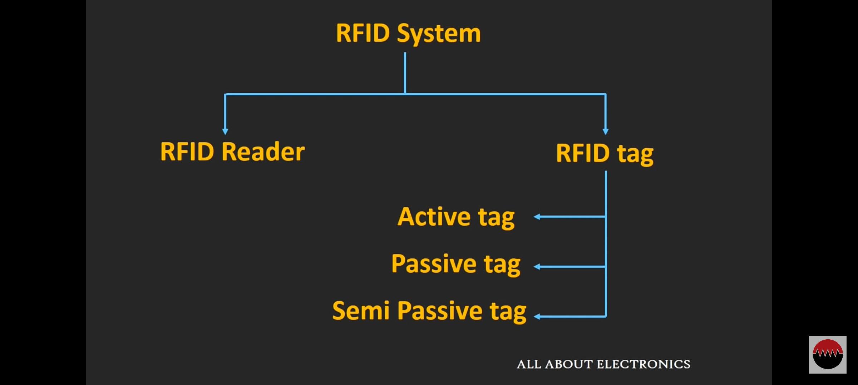
ACTIVE TAG:
An RFID tag can be defined as an active tag, when it has its own power source and allows the user to erase and update the data inside the tag.
Active tags are available with an external battery.
They are expensive compared to passive tags.
PASSIVE TAG:
Passive tags are activated only when it receives a signal from the reader.
These tags do not use any external battery. They are powered up by using the power from RFID reader.
The data in the passive tags is pre written. One cannot change the data in these tags.
These tags are generally used for applications such as file tracking, race timing etc.

Slide 9
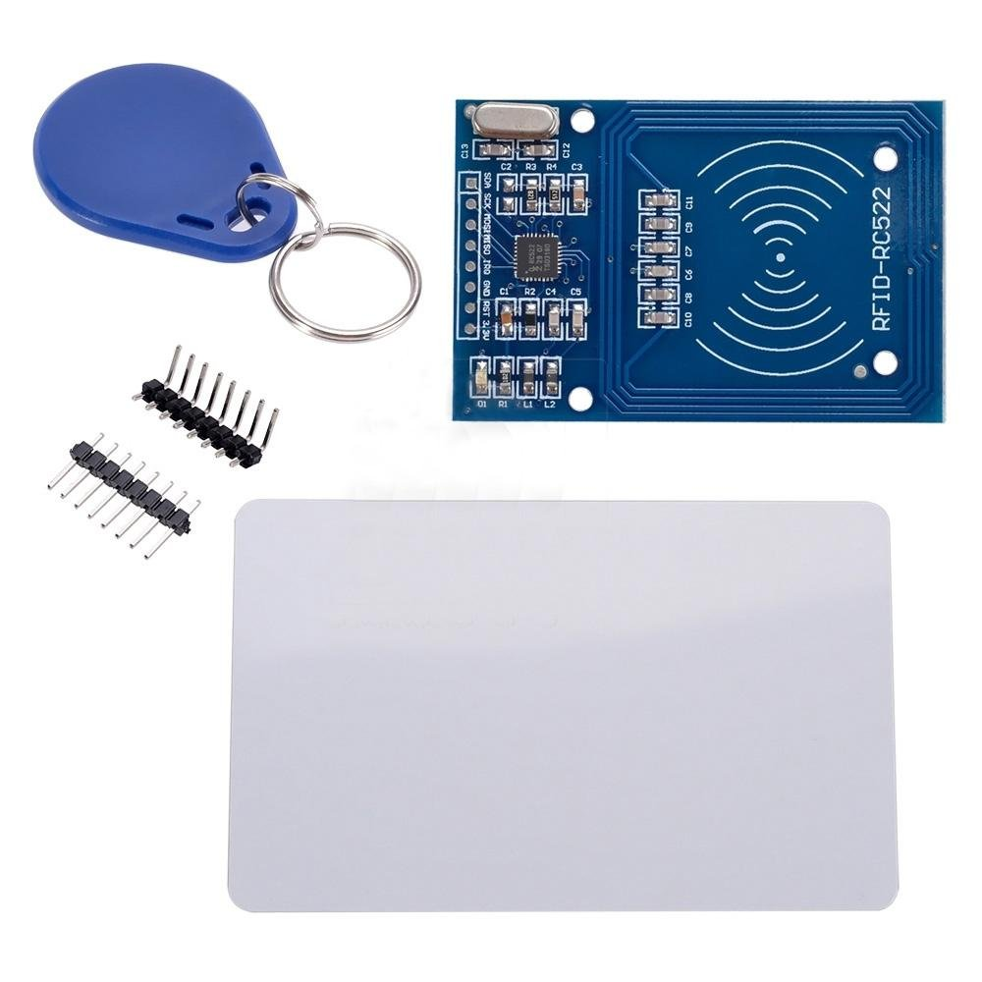
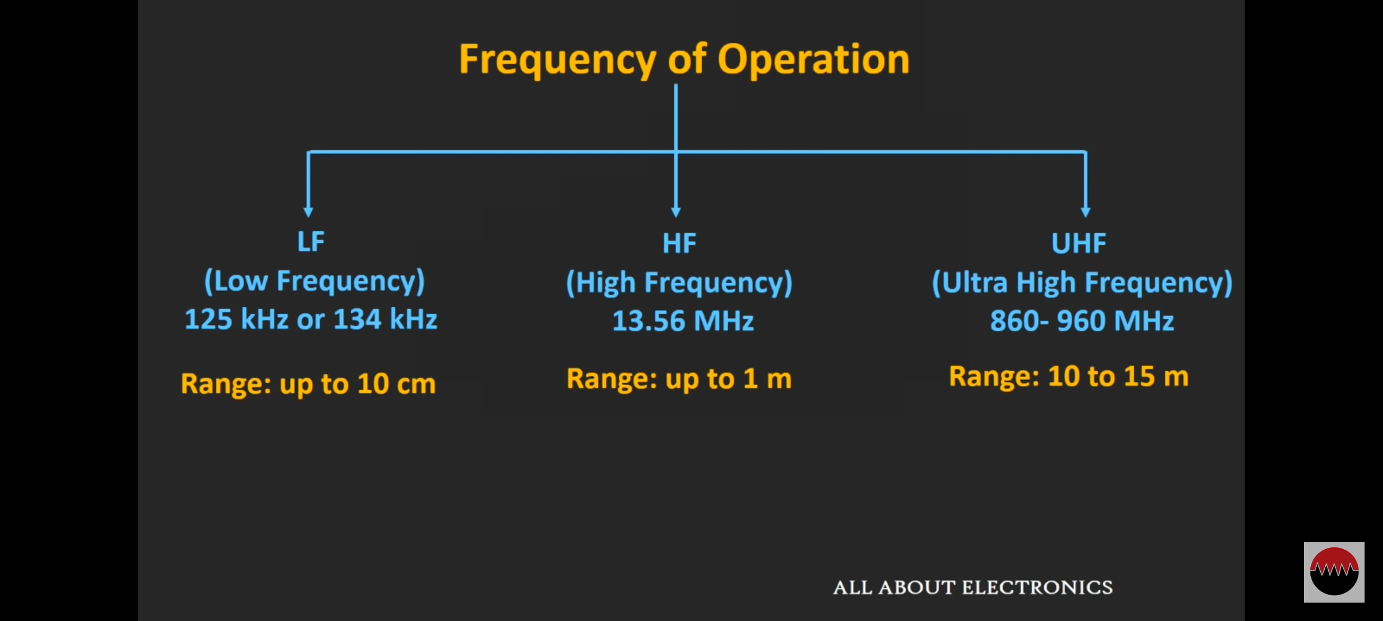
MFRC522 RFID Reader and RFID Tag

Slide 10
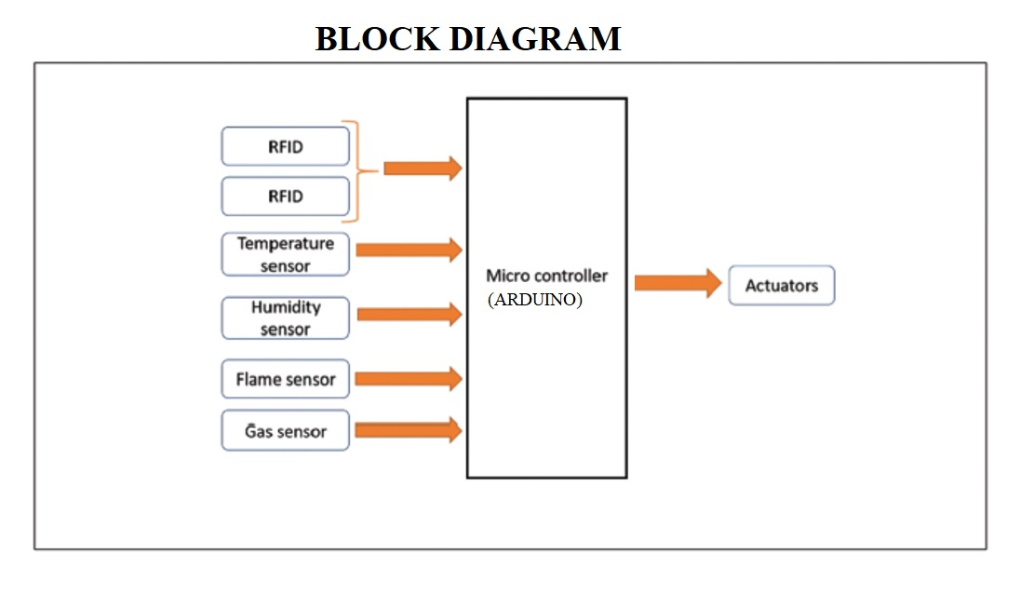

Slide 11
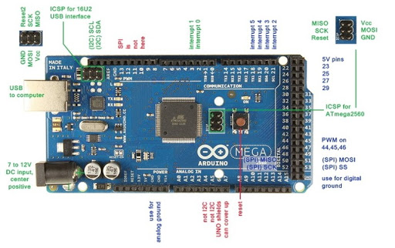
ARDUINO MEGA:
It is a microcontroller board based on the ATmega 1280.It has 54 Digital I/O pins and 16 Analog Inputs.
It has 4 UARTs(Universal Asynchronous Receiver/Transmitter),
a 16MHz crystal oscillator, a USB connection, a power jack,
an ICSP(In Circuit Serial Programming) header and a Reset
button.
The programming of an Arduino Mega can be done with the help of an IDE(Arduino Software) and it supports C-programming language
There are three ways to power the board.We can either use a USB cable or power it by using Vin on the board or through Power jack or battery.

Slide 12
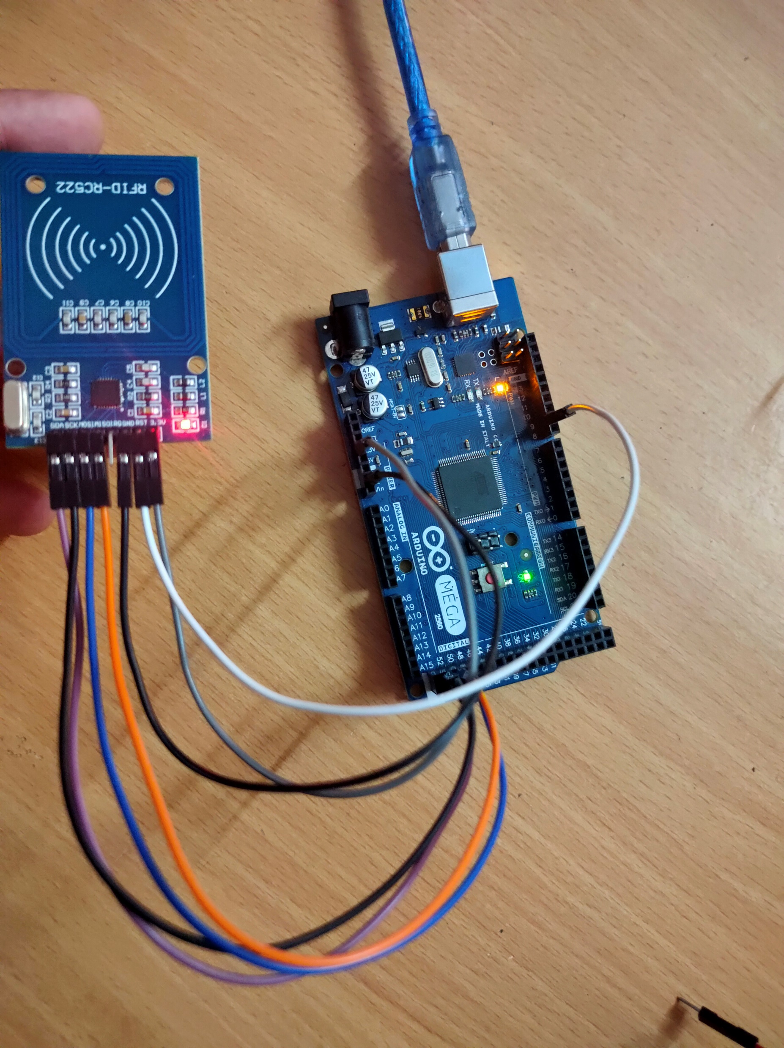
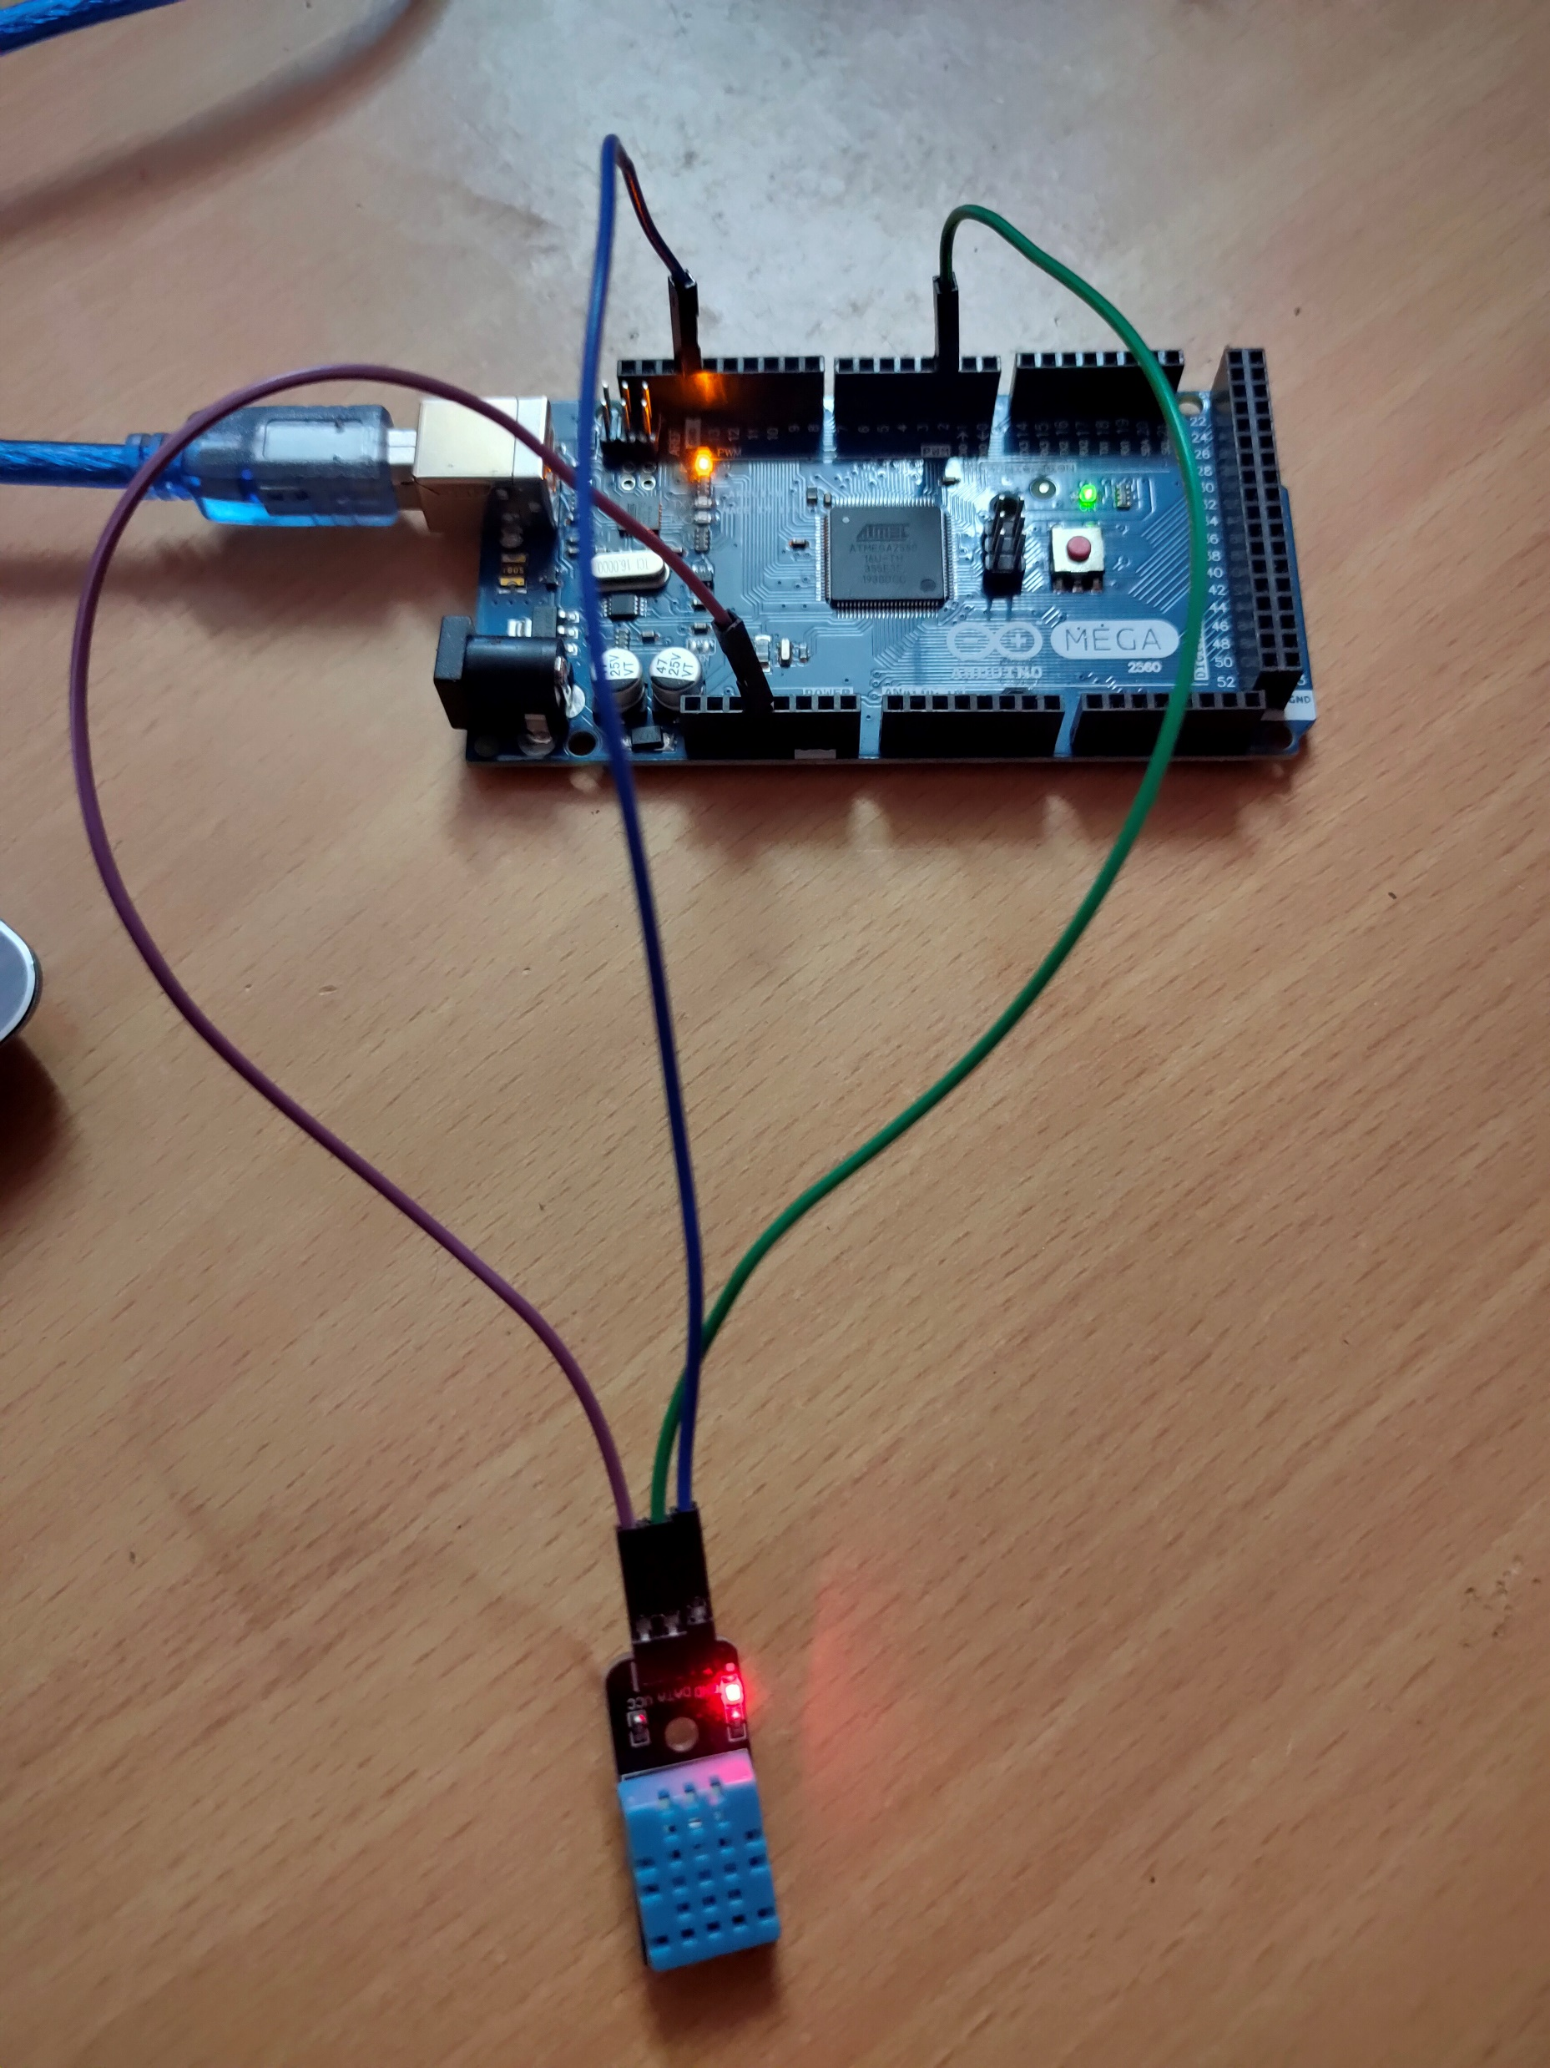
INTERFACINGS DONE :
Interfacing OF MFRC522
Interfacing of MQ2

Slide 13

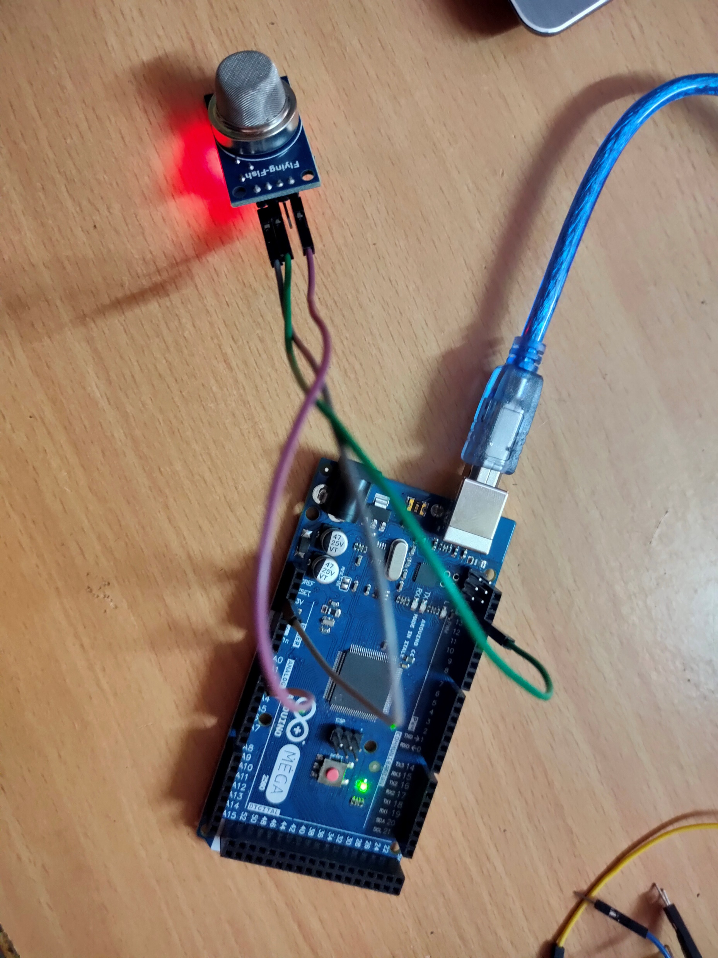
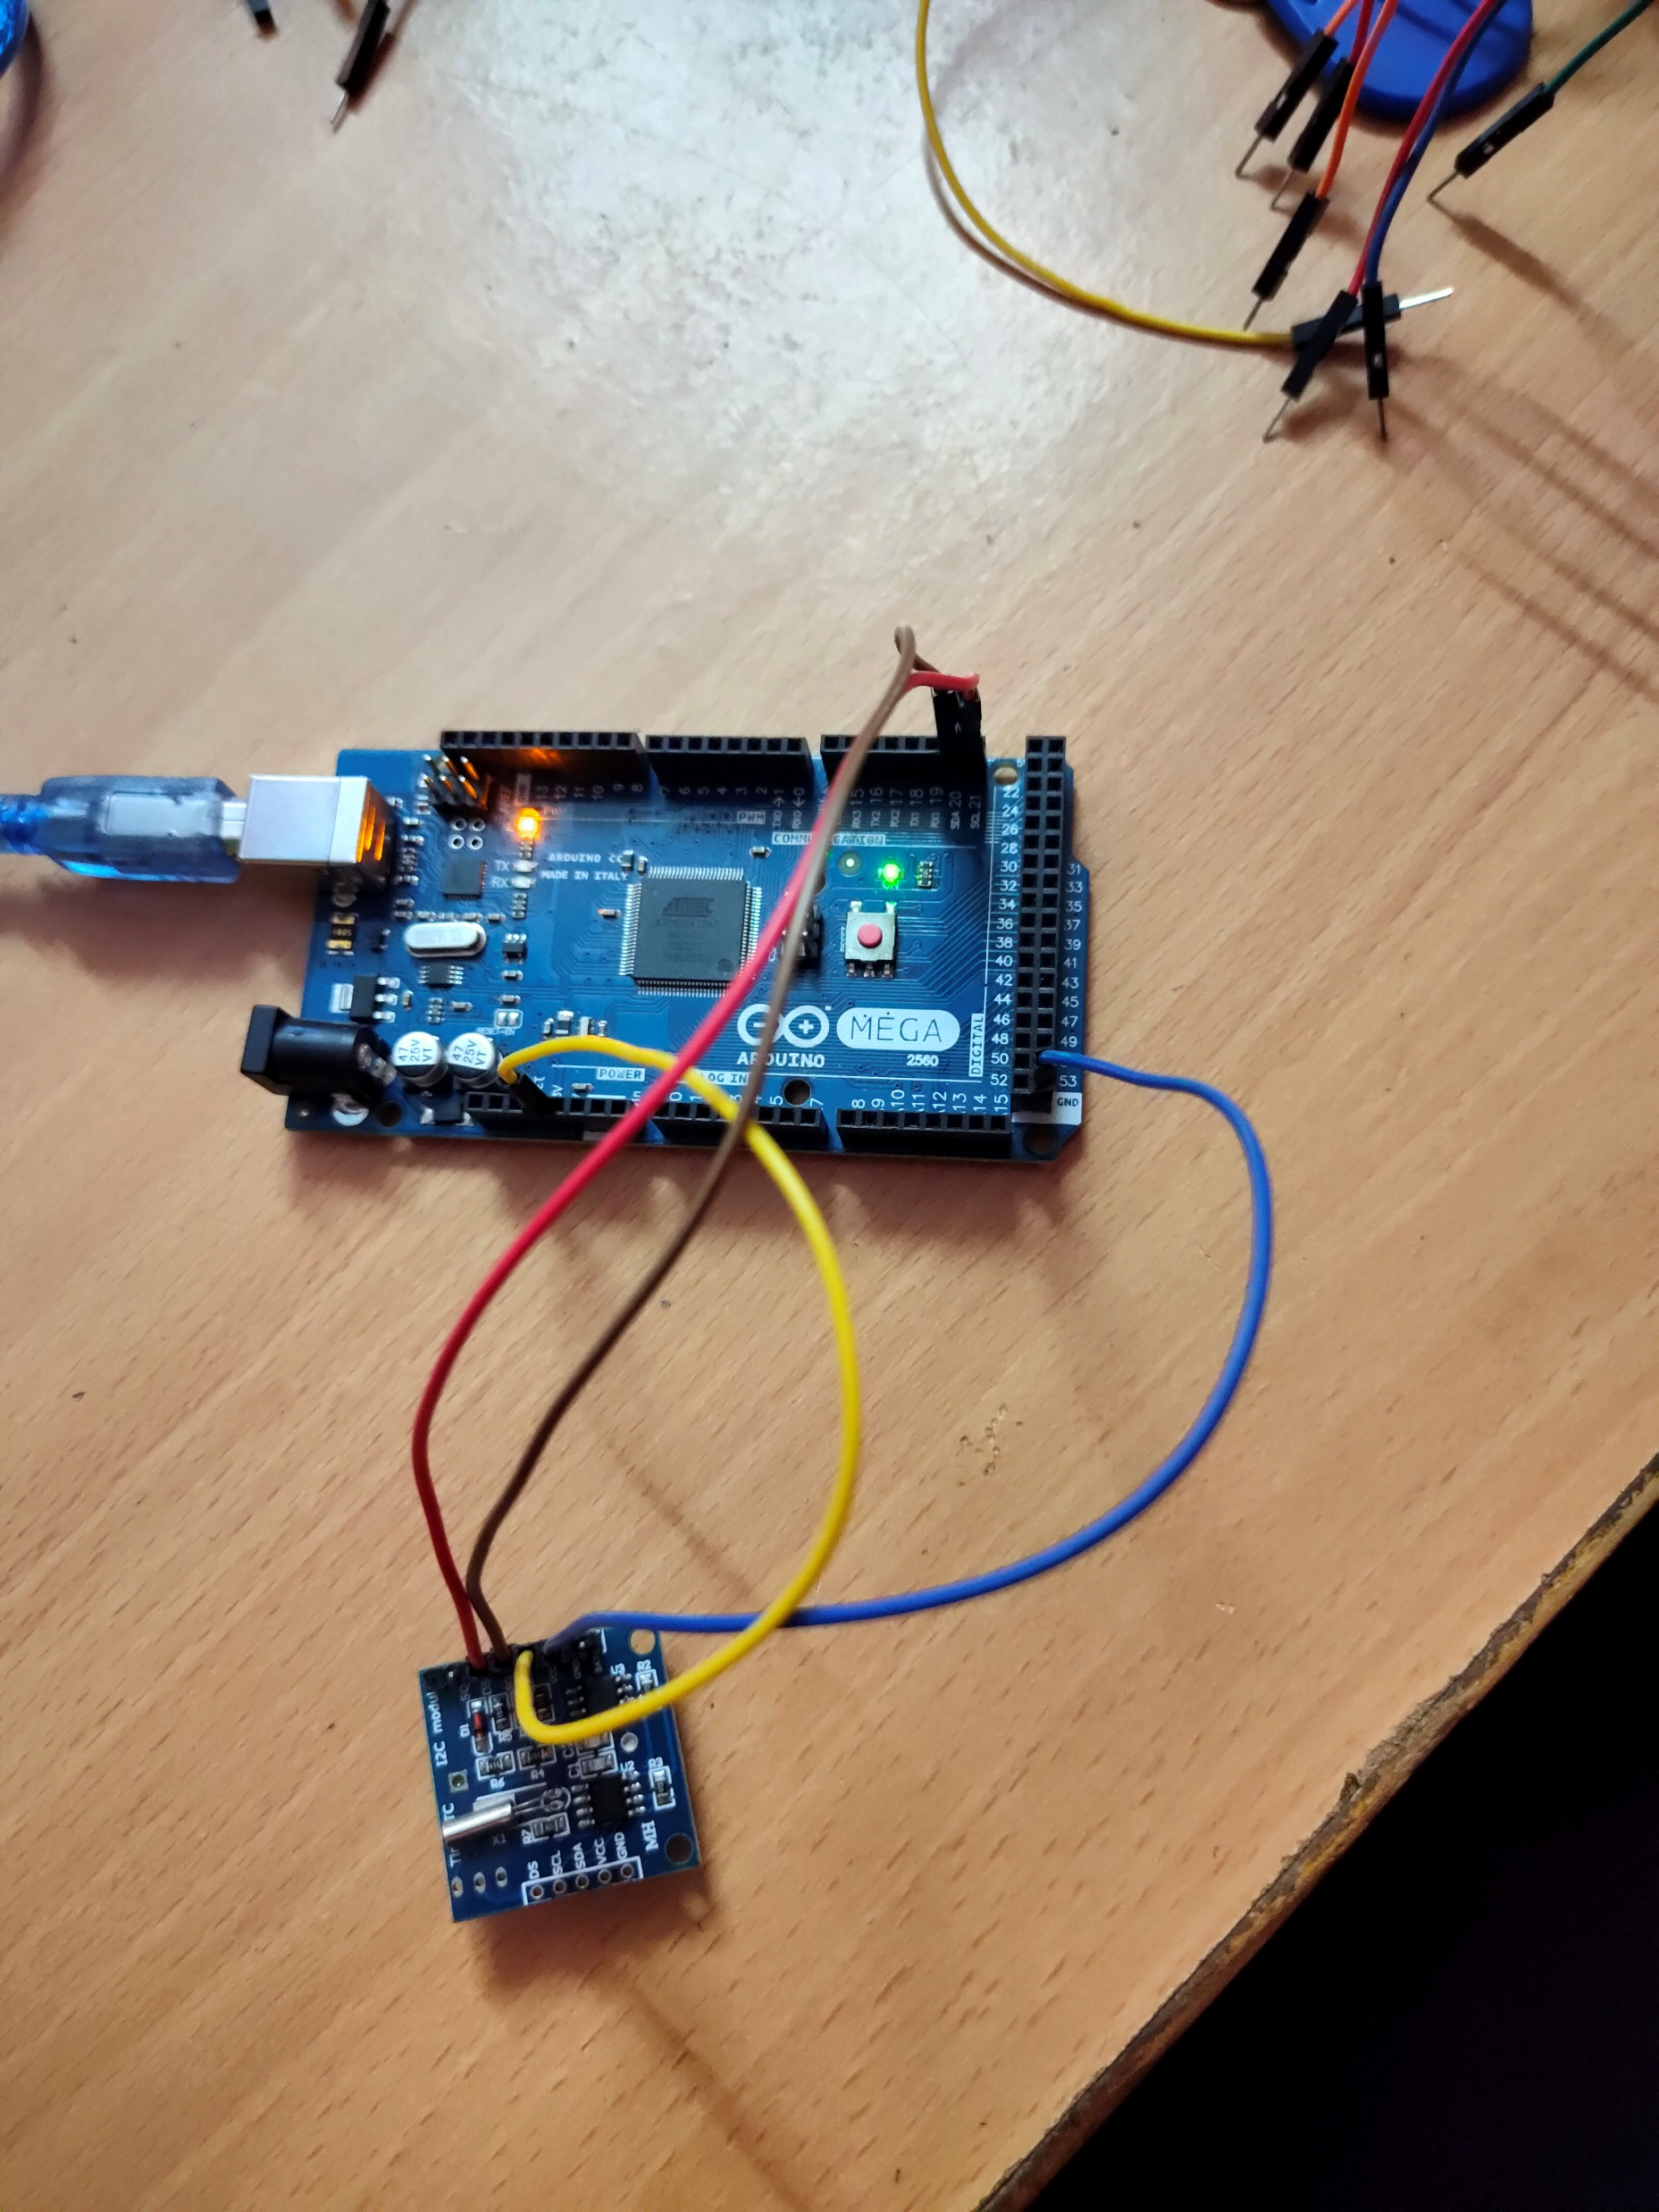
Interfacing of MQ2
Interfacing of RTC

Slide 14
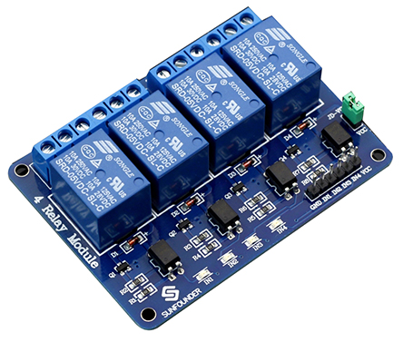
4 channel relay module :
A relay is defined as an electrically operated switch.
Their main use is controlling circuits by a low-power signal or when several circuits must be controlled by one signal.
It consists of 6 pins. One is for ground and other is for VCC.
The other four pins are for connecting inputs signals.
The output connections will be made the other side of it i.e, NC, COM , NO ….

Slide 15
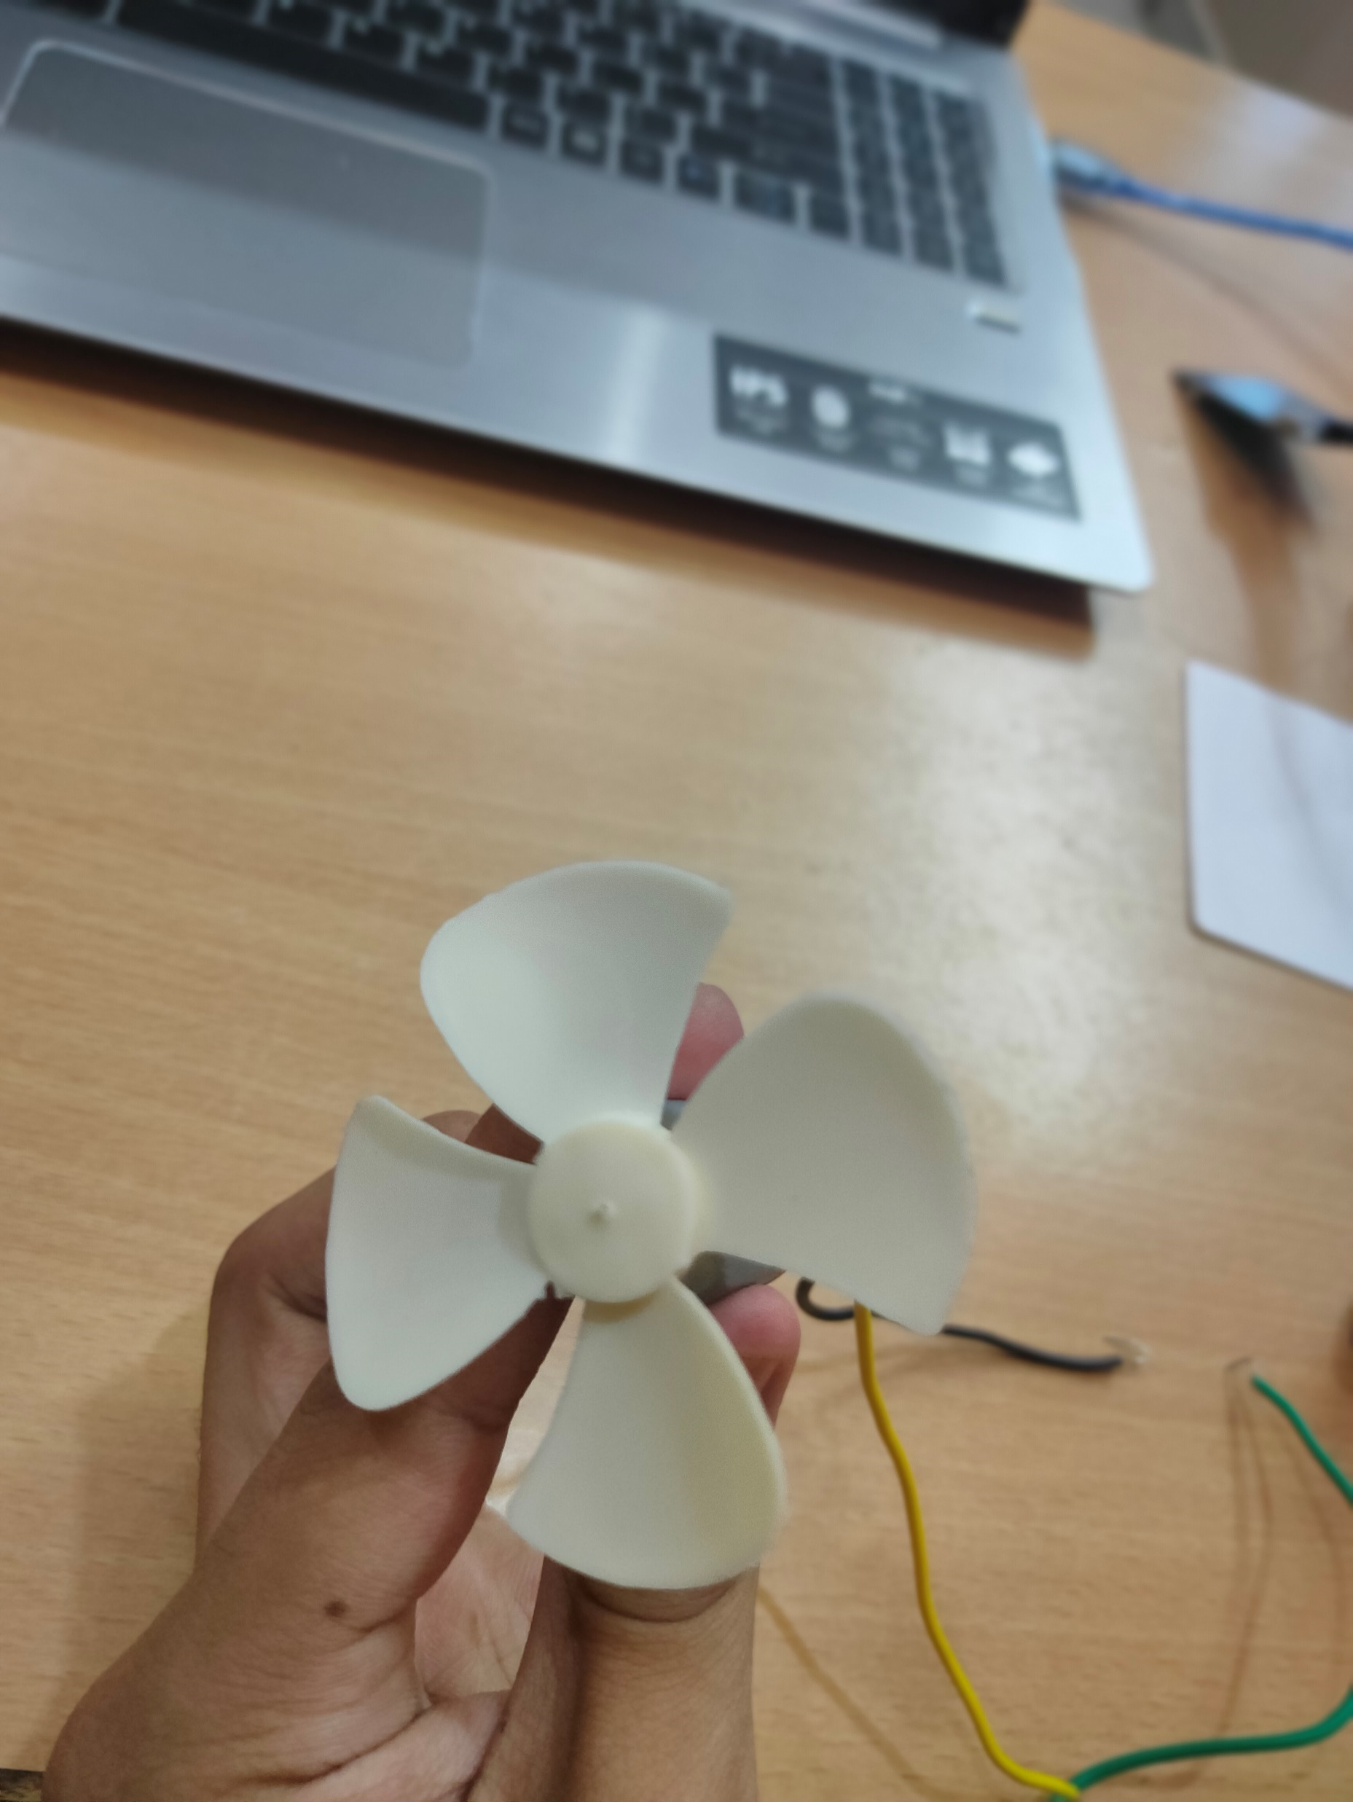
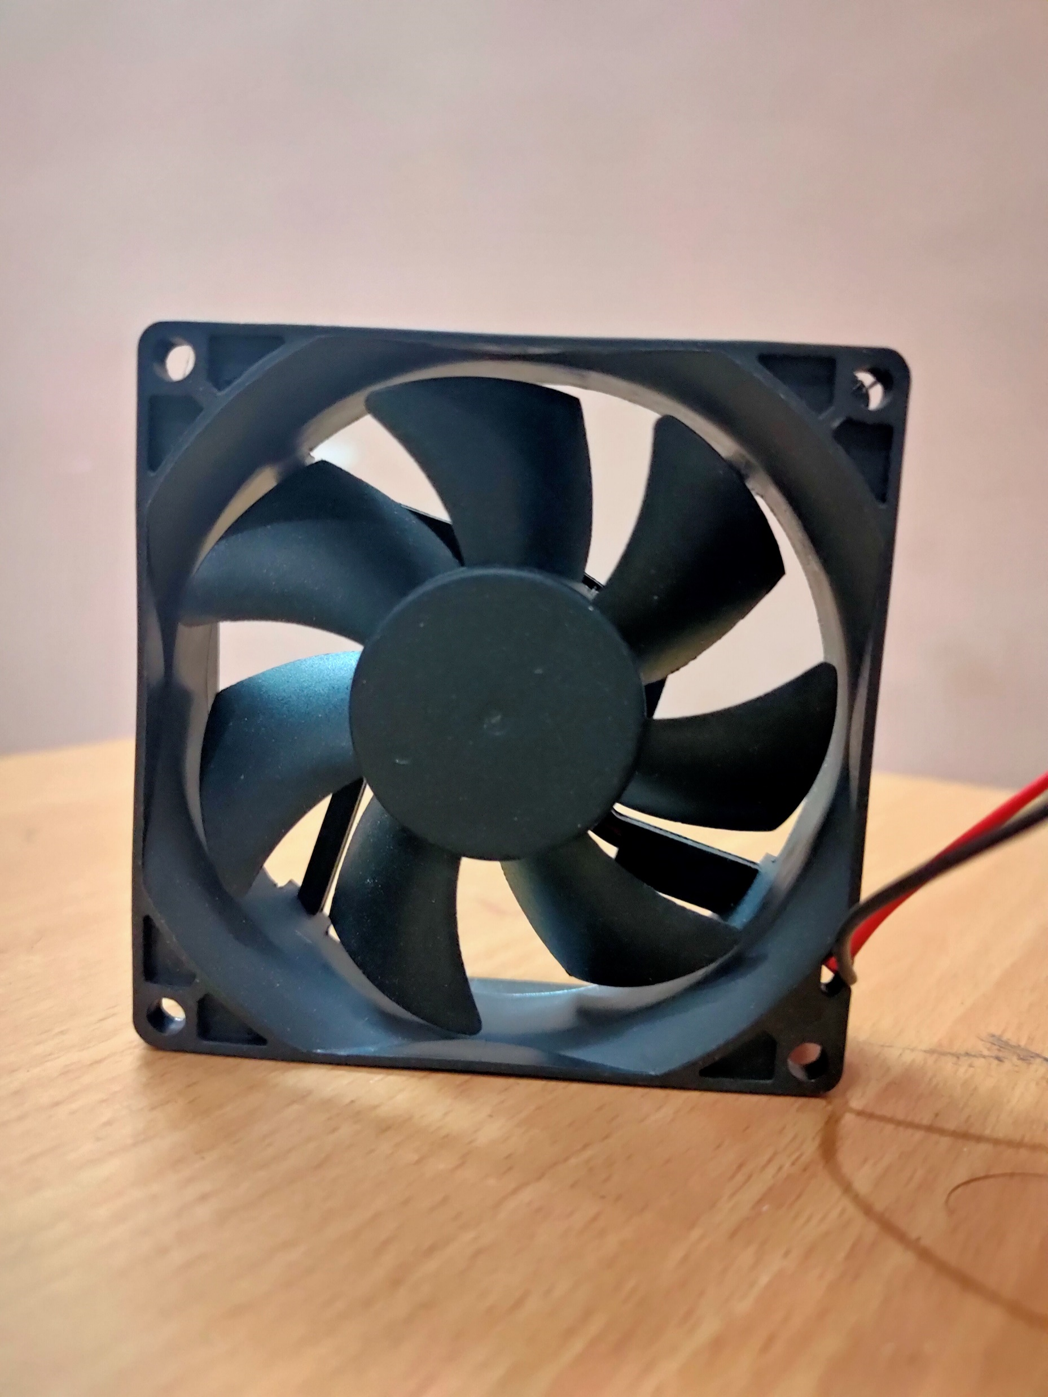
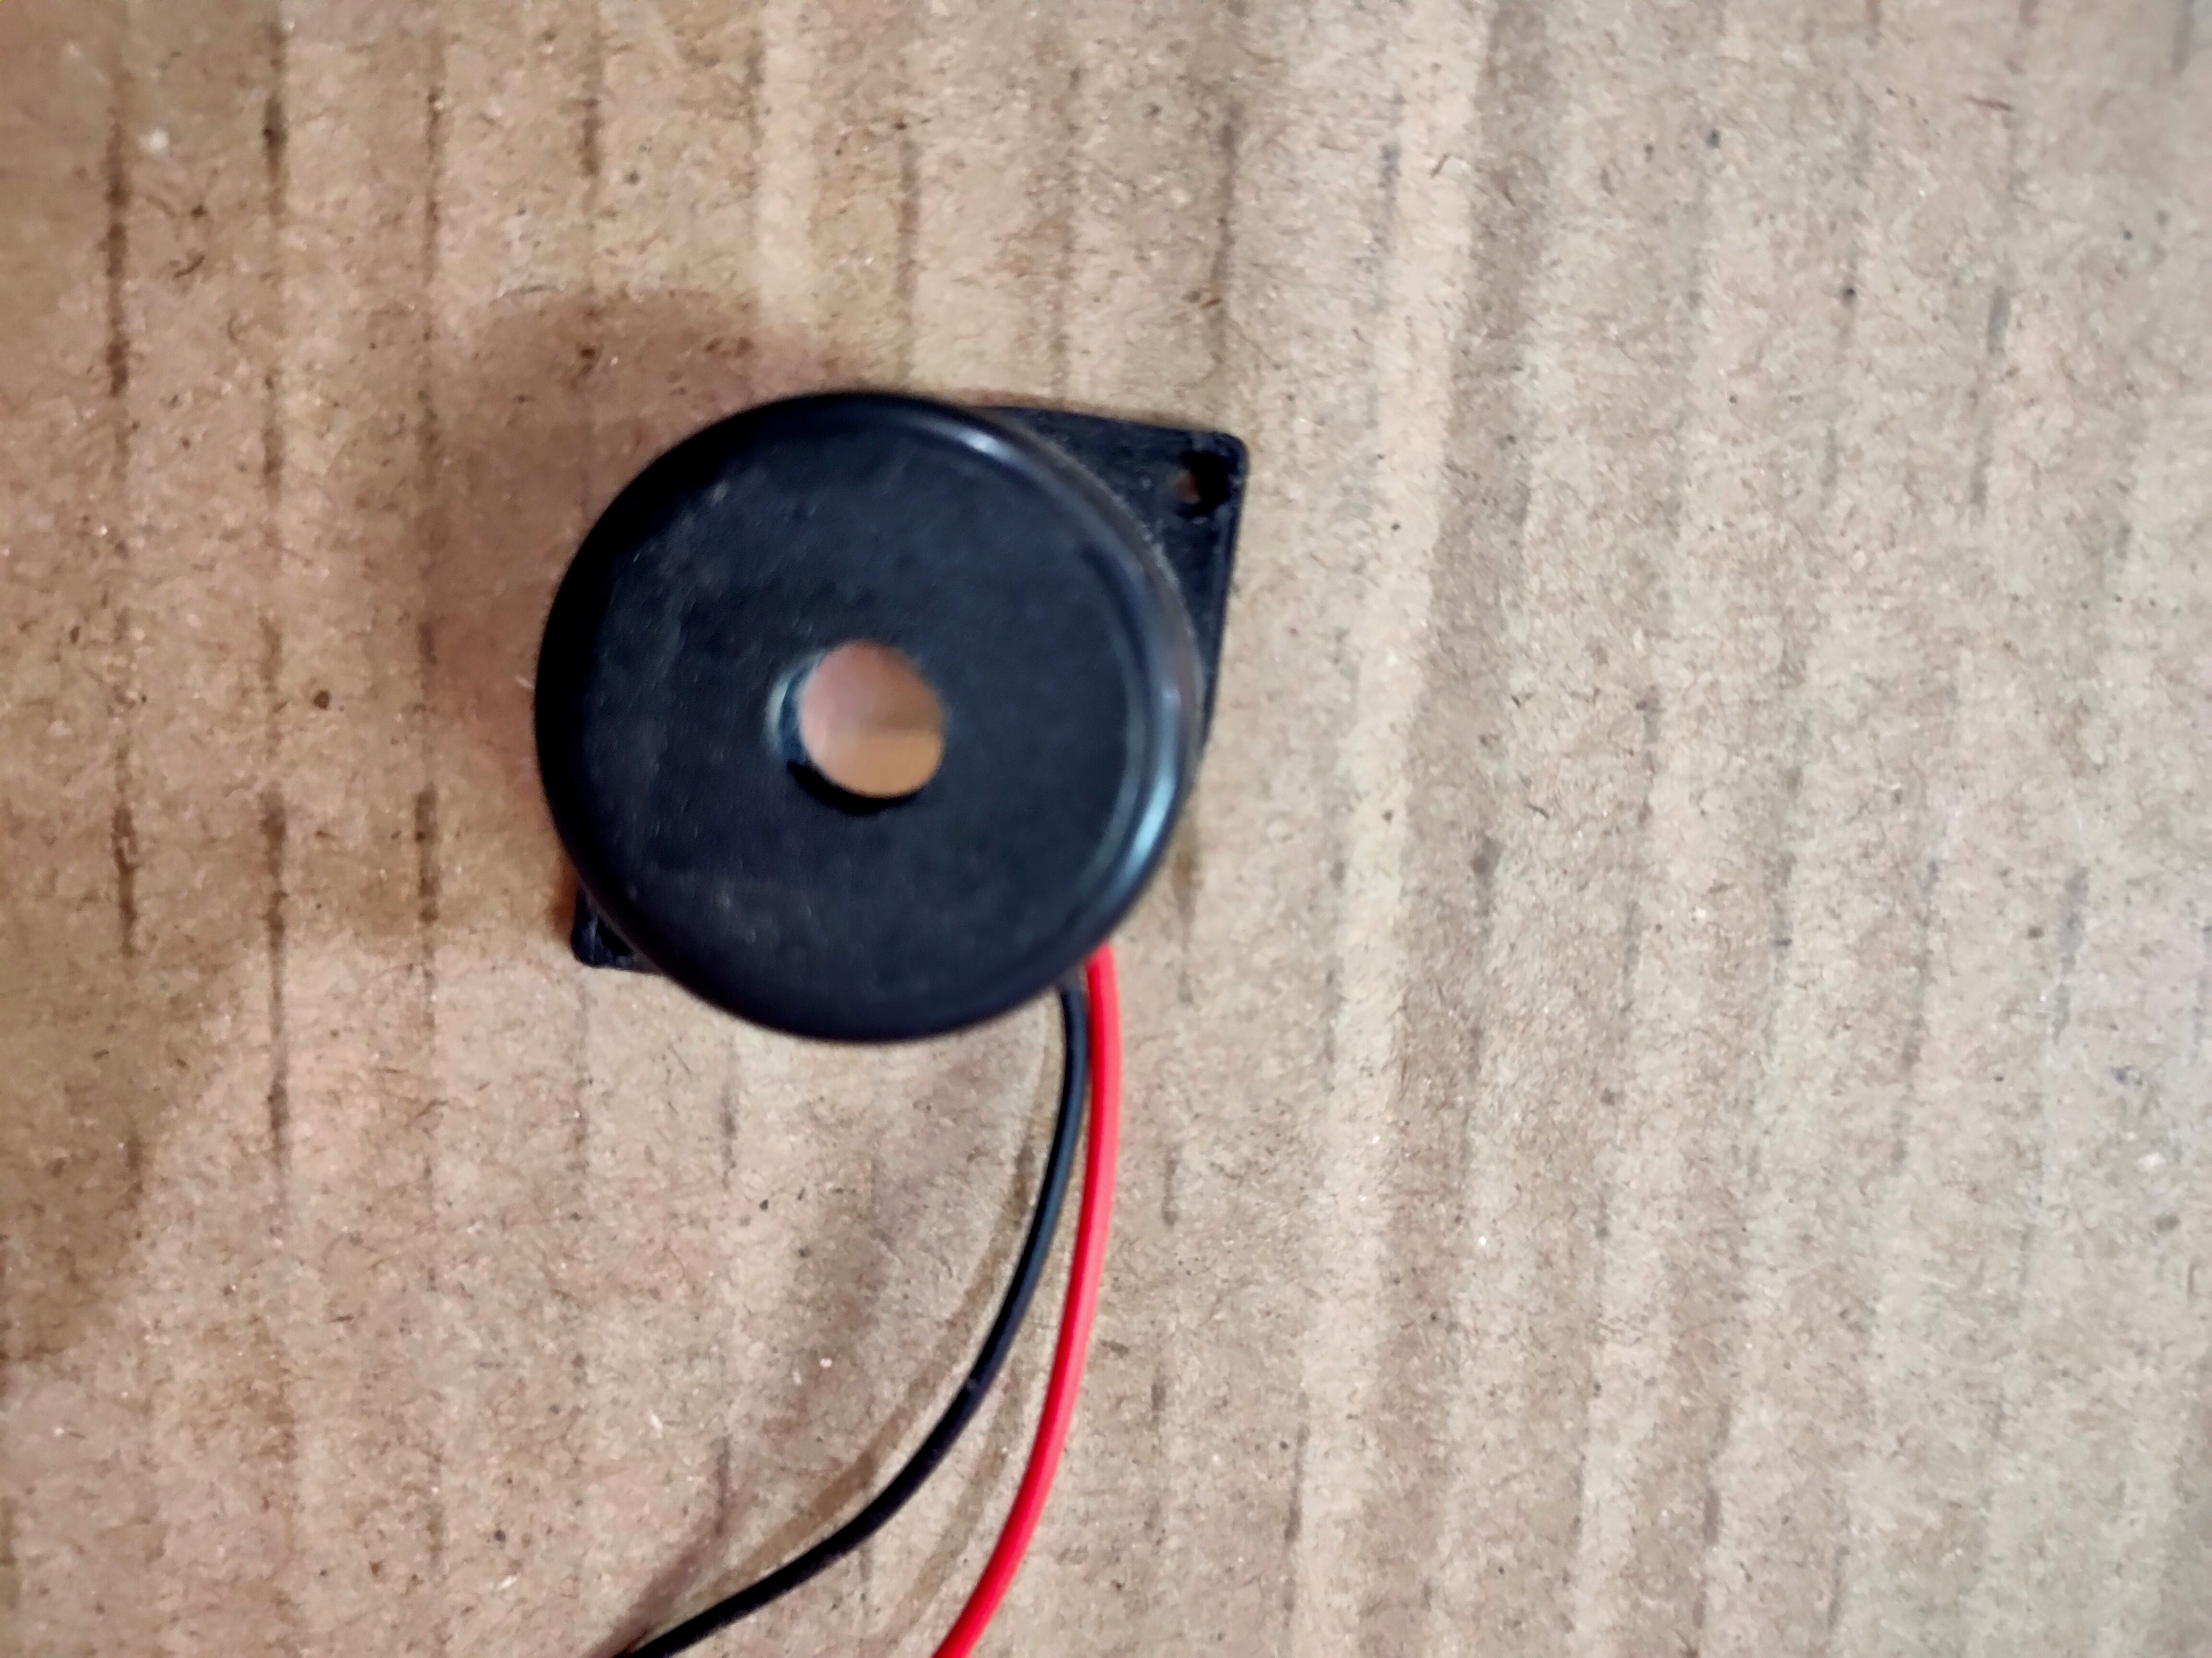
Actuators used :
COOLING FAN
EXHAUST FAN
BUZZER

Slide 16
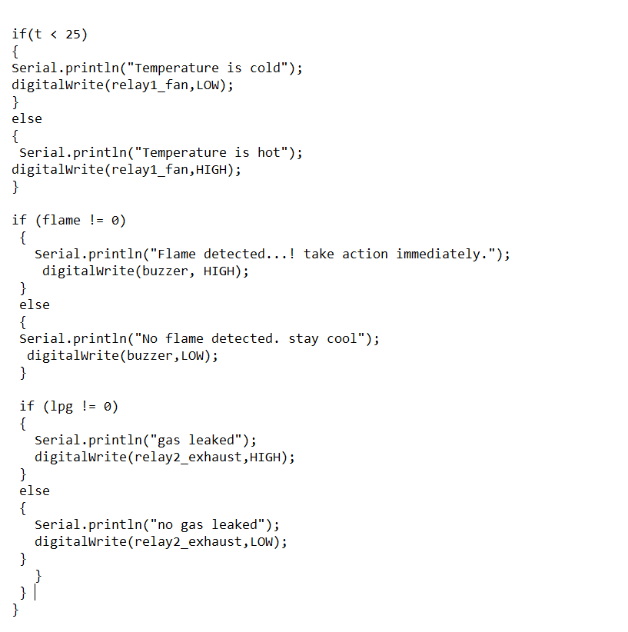
CODE LOGIC :

Slide 17
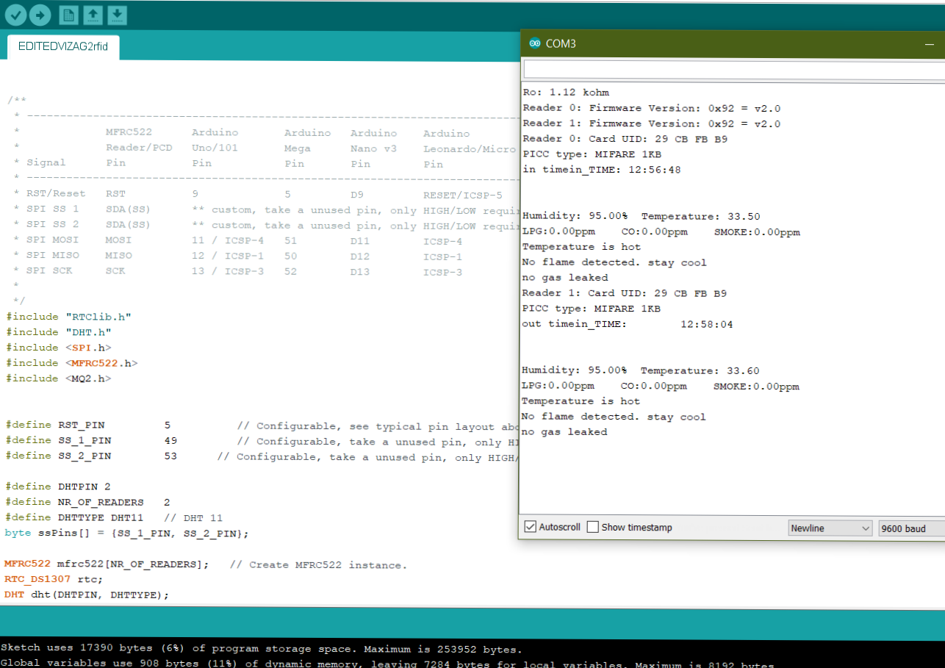
RESULTS :

Slide 18
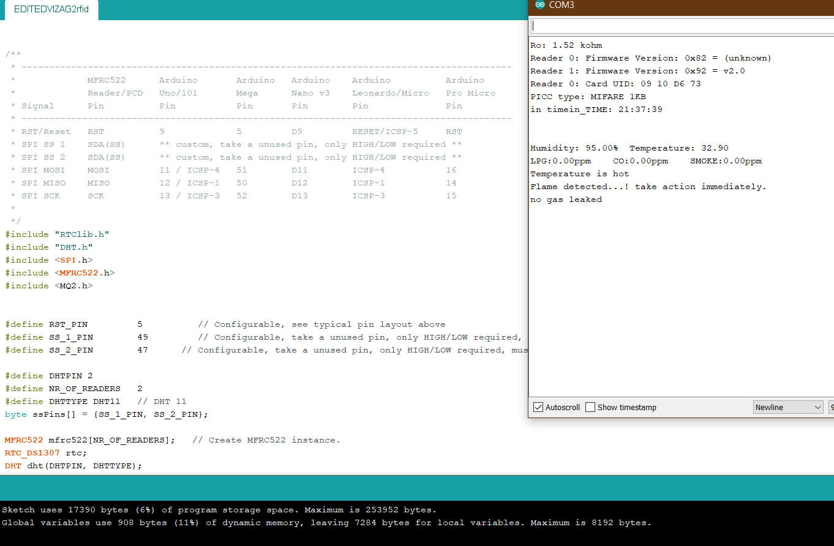
RESULTS :

Slide 19
Applications:
E-passport
Attendance System
People Tracking System
Groceries tracing
Toll collection system

Slide 20
CONCLUSIONS & future scope:
This project aim is to propose the safety in our homes and security in any mass gathering places.
By using actuators, the surrounding environment is controlled without having any dangerous results.
Also by using RFID the safety and security of visitors are constantly monitored.
By using IOT, the data from all the sensors cn be done and analytics is done and this data can be displayed as graphs in both websites and mobile app for better exploration.

Slide 21
REFERENCES:
1..Shuvashis Dey, Jhantu Kumar Saha, Nemai Chandra Karmakar,”Smart Sensing.”
2.C.M.Subhas, “Recent advancements in smart sensors and sensing technology,” in Advanced
RFID Systems, Security, and Applications, K. N.Chandra, Ed. Hershey, PA: IGI Global,
2013,pp. 334–353.
3. https://www.arduino.cc/
4.https://www.youtube.com/watch?v=EdXQUEMOfgU&list=PLPK2l9Knytg5s2dk8V0
9thBmNl2g5pRSr

Slide 22
THANK YOU

